Slide 1
Other Discrete Distributions
CS 109
Lecture 8
April 13th, 2016

Slide 2
Probability for Extreme Weather?

Slide 3
Storing Data on DNA
We want to know the probability of 100 base pairs being corrupted?
Probability of each base pair being corrupted is 10⁻⁶
n = 4 base-pairs
X = number of bits corrupted. X ~ Bin(4, 0.1)
In real networks, send large bit strings (length n ≈ 10⁴)
Probability of bit corruption is very small p ≈ 10⁻⁶
X ~ Bin(10⁴, 10⁻⁶) is unwieldy to compute
Extreme n and p values arise in many cases
# bit errors in file written to disk (# of typos in a book)
# visitors to a popular website
# of servers crashes in a day in giant data center
# Facebook login requests that go to particular server

Slide 5
Facebook Likes
Let’s try and calculate the probability of different nu
N is the number of people who see your post
“Maximum Likelihood” estimate
Set N to be value that maximizes:

Slide 6


Bernoulli vs Binomial
Bernoulli is a type of RV that can take on two values, 1 (for success) with probability p and 0 (for failure) with probability (1- p)
Binomial is the sum of n
Bernoullis
+
+
+
=

Slide 7
Storing Data on DNA
All the movies, images, emails and other digital data from more than 600 basic smartphones (10,000 gigabytes) can be stored in the faint pink smear of DNA at the end of this test tube.

Slide 8
Whither the Binomial
Recall example of sending bit string over network
n = 4 bits sent over network where each bit had independent probability of corruption p = 0.1
X = number of bits corrupted. X ~ Bin(4, 0.1)
In DNA (and real networks), send large strings (length n ≈ 10⁴)
Probability of corruption is very small p ≈ 10⁻⁶
X ~ Bin(10⁴, 10⁻⁶) is unwieldy to compute
Extreme n and p values arise in many cases
# bit errors in steam sent over a network
# visitors to a popular website
# of servers crashes in a day in giant data center
# Facebook login requests that go to particular server

Slide 9
Binomial in the Limit
Recall the Binomial distribution
Let λ = np (equivalently: p = λ/n)
When n is large, p is small, and λ is “moderate”:
Yielding:

Slide 10
Poisson Random Variable
X is a Poisson Random Variable: X ~ Poi(λ)
X takes on values 0, 1, 2…
and, for a given parameter λ > 0,
has distribution (PMF):
Note Taylor series:
So:

Slide 11
Sending Data on Network Redux
Recall example of sending bit string over network
Send bit string of length n = 10⁴
Probability of (independent) bit corruption p = 10⁻⁶
X ~ Poi(λ = 10⁴ * 10⁻⁶ = 0.01)
What is probability that message arrives uncorrupted?
Using Y ~ Bin(10⁴, 10⁻⁶):
Caveat emptor: Binomial computed with built-in function in python software package, so some approximations may have occurred. Approximations are closer to you than they may appear in some software packages.

Slide 12
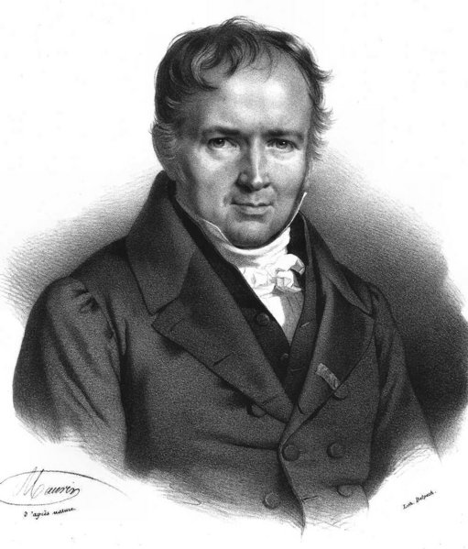
Simeon-Denis Poisson
Simeon-Denis Poisson (1781-1840) was a prolific French mathematician
Published his first paper at 18, became professor at 21, and published over 300 papers in his life
He reportedly said “Life is good for only two things, discovering mathematics and teaching mathematics.”
I’m going with French Martin Freeman

Slide 13
Poisson is Binomial in the Limit
Poisson approximates Binomial where n is large, p is small, and λ = np is “moderate”
Different interpretations of "moderate"
n > 20 and p < 0.05
n > 100 and p < 0.1
Really, Poisson is Binomial as
n → ∞ and p → 0, where np = λ

Slide 14
Bin(10,0.3) vs Bin(100,0.03) vs Poi(3)
P(X = k)
k

Slide 15
Tender (Central) Moments with Poisson
Recall: Y ~ Bin(n, p)
E[Y] = np
Var(Y) = np(1 – p)
X ~ Poi(λ) where λ = np (n → ∞ and p → 0)
E[X] = np = λ
Var(X) = np(1 – p) = λ(1 – 0) = λ
Yes, expectation and variance of Poisson are same
It brings a tear to my eye…

Slide 16
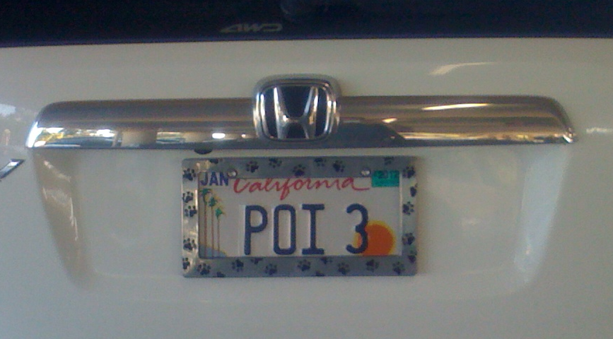
A Real License Plate Seen at Stanford
No, it’s not mine…
but I kind of wish it was.

Slide 17
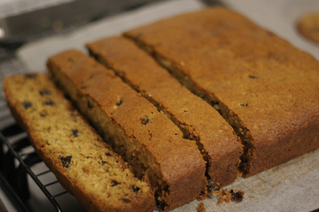
It’s Really All About Raisin Cake
Bake a cake using many raisins and lots of batter
Cake is enormous (in fact, infinitely so…)
Cut slices of “moderate” size (w.r.t. # raisins/slice)
Probability p that a particular raisin is in a certain slice is very small (p = 1/# cake slices)
Let X = number of raisins in a certain cake slice
X ~ Poi(λ), where

Slide 18
CS = Baking Raisin Cake with Code
Hash tables
strings = raisins
buckets = cake slices
Server crashes in data center
servers = raisins
list of crashed machines = particular slice of cake
Facebook login requests (i.e., web server requests)
requests = raisins
server receiving request = cake slice

Slide 19
Defective Chips
Computer chips are produced
p = 0.1 that a chip is defective
Consider a sample of n = 10 chips
What is P(sample contains ≤ 1 defective chip)?
Using Y ~ Bin(10, 0.1):
Using X ~ Poi(λ = (0.1)(10) = 1)

Slide 20
Efficiently Computing Poisson
Let X ~ Poi(λ)
Want to compute P(X = i ) for multiple values of i
E.g., Computing
Iterative formulation:
Compute P(X = i + 1) from P(X = i)
Use recurrence relation:

Slide 21
Poisson is all about the Meh
Poisson can still provide a good approximation even when assumptions are “mildly” violated
“Poisson Paradigm”
Can apply Poisson approximation when...
“Successes” in trials are not entirely independent
Example: # entries in each bucket in large hash table
Probability of “Success” in each trial varies (slightly)
Small relative change in a very small p
Example: average # requests to web server/sec. may fluctuate slightly due to load on network

Slide 22
Birthday Problem Redux
What is the probability that of m people, none share the same birthday (regardless of year)?
trials, one for each pair of people (x, y), x ≠ y
Let E_{x,y} = x and y have same birthday (trial success)
P(E_{x,y}) = p = 1/365 (note: all E_{x,y} not independent)
X ~ Poi(λ) where
Solve for smallest integer m, s.t.:
Same as before!

Slide 23
Poisson Process
Consider “rare” events that occur over time
Earthquakes, radioactive decay, hits to web server, etc.
Have time interval for events (1 year, 1 sec, whatever...)
Events arrive at rate: λ events per interval of time
Split time interval into n → ∞ sub-intervals
Assume at most one event per sub-interval
Event occurrences in sub-intervals are independent
With many sub-intervals, probability of event occurring in any given sub-interval is small
N(t) = # events in original time interval ~ Poi(λ)

Slide 24
Web Server Load
Consider requests to a web server in 1 second
In past, server load averages 2 hits/second
X = # hits server receives in a second
What is P(X = 5)?
Model
Assume server cannot acknowledge > 1 hit/msec.
1 sec = 1000 msec. (= large n)
P(hit server in 1 msec) = 2/1000 (= small p)
X ~ Poi(λ = 2)

Slide 25
Probability for Extreme Weather?

Slide 26
Hurricanes per Year since 1851

Slide 27


Four Prototypical Trajectories
To the code!

Slide 28
Historically ~ Poisson(8.5)
Until 1966, things look pretty Poisson
Lambda = 8.5

Slide 29
Improbability Drive
What is the probability of over 15 hurricanes in a season given that the distribution doesn’t change?
Let X = # hurricanes in a year. X ~ Poi(8.5)
Solution:
This is the pdf of a Poisson. Your favorite programming language has a function for it

Slide 30
Four Prototypical Trajectories
Twice since 1966 there have been years with over 30 hurricanes

Slide 31
Improbability Drive
What is the probability of over 30 hurricanes in a season given that the distribution doesn’t change?
Let X = # hurricanes in a year. X ~ Poi(8.5)
Solution:
This is the pdf of a Poisson. Your favorite programming language has a function for it

Slide 32
The Distribution has Changed
Since 1966, looks like the distribution has changed
Lambda = 16.6?

Slide 33
What’s Up?

Slide 34
Four Prototypical Trajectories
Pause

Slide 35
Discrete Distributions
Don’t have to memorize all of the following distributions.
We want you to get a sense of how random variables work

Slide 36
Geometric Random Variable
X is Geometric Random Variable: X ~ Geo(p)
X is number of independent trials until first success
p is probability of success on each trial
X takes on values 1, 2, 3, …, with probability:
E[X] = 1/p Var(X) = (1 – p)/p²
Examples:
Flipping a coin (P(heads) = p) until first heads appears
Urn with N black and M white balls. Draw balls (with replacement, p = N/(N + M)) until draw first black ball
Generate bits with P(bit = 1) = p until first 1 generated

Slide 37
Negative Binomial Random Variable
X is Negative Binomial RV: X ~ NegBin(r, p)
X is number of independent trials until r successes
p is probability of success on each trial
X takes on values r, r + 1, r + 2…, with probability:
E[X] = r /p Var(X) = r (1 – p)/p²
Note: Geo(p) ~ NegBin(1, p)
Examples:
# of coin flips until r-th “heads” appears
# of strings to hash into table until bucket 1 has r entries

Slide 38
Hypergeometric Random Variable
X is Hypergeometric RV: X ~ HypG(n, N, m)
Urn with N balls: (N – m) black and m white
Draw n balls without replacement
X is number of white balls drawn
E[X] = n(m /N) Var(X) = [nm (N – n)(N – m)]/[N²(N – 1)]
Let p = m /N (probability of drawing white on 1st draw)
Note: HypG(n, N, m) → Bin(n, m/N)
As N → ∞ and m/N remains constant

Slide 39

Endangered Species
Determine N = how many of some species remain
Randomly tag m of species (e.g., with white paint)
Allow animals to mix randomly (assuming no breeding)
Later, randomly observe another n of the species
X = number of tagged animals in observed group of n
X ~ HypG(n, N, m)
“Maximum Likelihood” estimate
Set N to be value that maximizes:

